Slide 1
A Tree is a non-linear data structure used to represent hierarchical relationships.
Key Properties:
Consists of nodes and edges
One node is the root
Every node can have children
Terminology:
Root : Top node
Parent / Child : Relationship between nodes
Leaf Node : Node with no children
Subtree : Tree inside a tree
Depth : Distance from root
Height : Longest path to leaf
A
/ \
B C
/ \
D E

Slide 2
class Node:
def __init__(self, data):
self.data = data
self.children = []
# Example creation
root = Node('A')
child1 = Node('B')
child2 = Node('C')
root.children.append(child1)
root.children.append(child2)

Slide 3
Uses of Trees
1. File Systems
OS stores directories as trees
2. Database Indexing
Trees like B-Trees, B+ Trees are used for fast searching
3. Searching Algorithms
Binary Search Trees allow O(log n) search (average)
4. AI & Decision Making
Decision Trees in Machine Learning

Slide 4

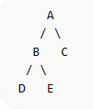
Shape of Binary Trees A Binary Tree is a tree where each node has at most 2 children.
1. Full Binary Tree
Every node has 0 or 2 children
2. Complete Binary Tree
All levels filled except last
Last level filled left to right

Slide 5
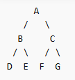
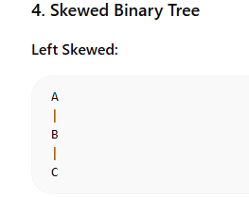
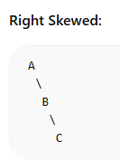
3. Perfect Binary Tree
All internal nodes have 2 children
All leaves at same level

Slide 6
Python Binary Tree Node
class BinaryNode:
def __init__(self, data):
self.data = data
self.left = None
self.right = None

Slide 7
Three Common Applications of Binary Trees
1. Binary Search Tree (BST)
Left child < Root < Right child
class BST:
def __init__(self):
self.root = None
def insert(self, root, key):
if root is None:
return BinaryNode(key)
if key < root.data:
root.left = self.insert(root.left, key)
else:
root.right = self.insert(root.right, key)
return root

Slide 8

2. Expression Tree
Used to evaluate expressions
Example: (3 + (2 * 5))
def evaluate(root):
if root.left is None and root.right is None:
return int(root.data)
left_val = evaluate(root.left)
right_val = evaluate(root.right)
if root.data == '+':
return left_val + right_val
elif root.data == '*':
return left_val * right_val

Slide 9
3. Heap (Priority Queue)
Complete Binary Tree
Used in priority scheduling
Types:
Min Heap : smallest element at root
Max Heap : largest element at root
Code:
import heapq
heap = []
heapq.heappush(heap, 10)
heapq.heappush(heap, 5)
heapq.heappush(heap, 20)
print(heapq.heappop(heap)) # Output: 5
Uses:
Scheduling algorithms
Dijkstra’s algorithm
Priority queues

Slide 10
3. Heap (Priority Queue)
Complete Binary Tree
Used in priority scheduling
Types:
Min Heap : smallest element at root
Max Heap : largest element at root
Code:
import heapq
heap = []
heapq.heappush(heap, 10)
heapq.heappush(heap, 5)
heapq.heappush(heap, 20)
print(heapq.heappop(heap)) # Output: 5
Uses:
Scheduling algorithms
Dijkstra’s algorithm
Priority queues

Slide 11
Q1:
A tree with n nodes has how many edges?
A) n
B) n − 1
C) n + 1
D) 2n
Notes:
Answer B
In any tree:
Edges=Nodes−1
This is because a tree is a connected acyclic graph

Slide 12
Q2:
Which node has no children?
A) Root
B) Internal node
C) Leaf node
D) Parent node
Notes:
Answer C

Slide 13
Q5:
A binary tree in which all levels are filled except possibly the last, and nodes are filled from left is called:
A) Full Binary Tree
B) Perfect Binary Tree
C) Complete Binary Tree
D) Skewed Tree
Notes:
Answer C

Slide 14
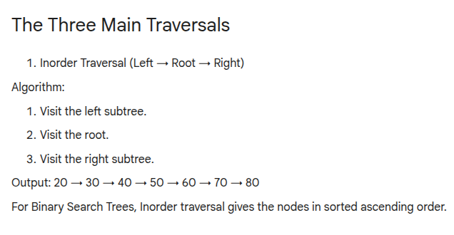
Notes:
Answer C

Slide 15
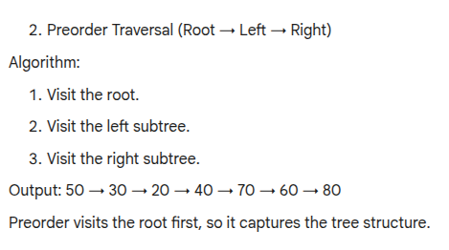
Notes:
Answer C

Slide 16
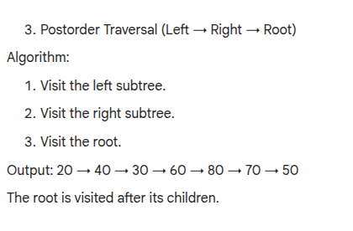
Notes:
Answer C

Slide 17
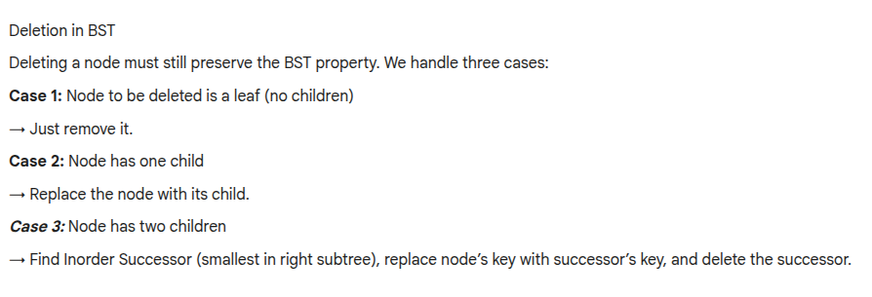
Notes:
Answer C

Slide 18
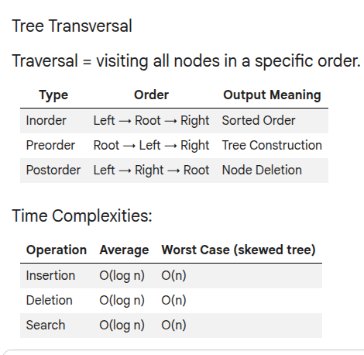
Notes:
Answer C

Slide 19
What is Parsing?
Parsing = analyzing a string according to grammar rules
Used in:
Compilers
Interpreters
Calculators
Real-life Example: 3 + 5 * 2 Parsing decides:
Order of evaluation
Structure of expression
Notes:
Answer C

Slide 20
2. Types of Expressions
1. Infix Expression
Operator between operands
A + B
2. Prefix Expression
+ A B
3. Postfix Expression
A B +
Notes:
Answer C

Slide 21
3. Operator Precedence
Operator | Priority
^ | High
*, / | Medium
+, - | Low
Notes:
Answer C

Slide 22
4. Infix → Postfix Conversion
Algorithm (Stack-based)
Scan expression left to right
If operand → output
If operator → push to stack
If higher precedence → push
If lower → pop until condition satisfied
If ( → push
If ) → pop until (
Notes:
Answer C

Slide 23
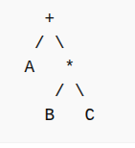
Expression Trees
1. What is an Expression Tree?
A binary tree representation of expressions
Leaves : operands
Internal nodes : operators
Expression: A + B * C
Notes:
Answer C

Slide 24
Node Structure in Python
class Node:
def __init__(self, value):
self.value = value
self.left = None
self.right = None
Notes:
Answer C

Slide 25
3. Construct Expression Tree from Postfix
Algorithm
Scan postfix expression
If operand → push node
If operator:
Pop two nodes
Create new node
Push back
Notes:
Answer C

Slide 26
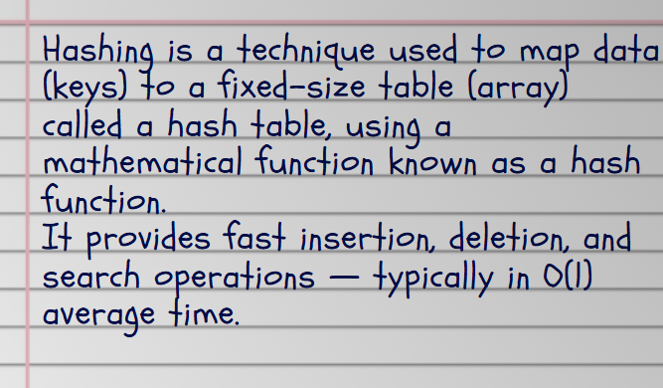
Hash Table

Slide 27
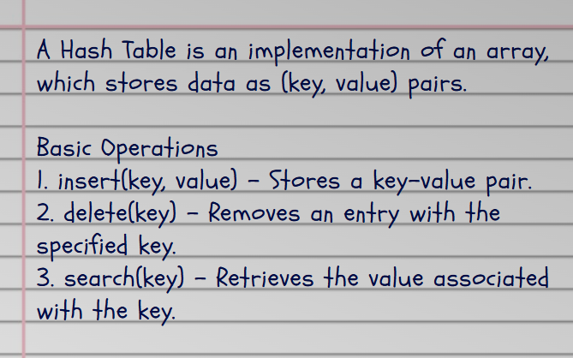
Hash Table ADT (Abstract Data Type)

Slide 28
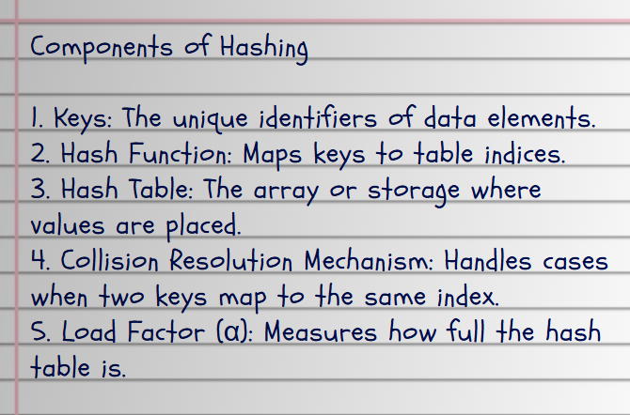
Hash Table ADT (Abstract Data Type)
Key | Hash Value (h(key)) | Index Value | Stored Value
12 | h(12) = 2 | 2 | "Apple"
44 | h(44) = 4 | 4 | "Mango"

Slide 29
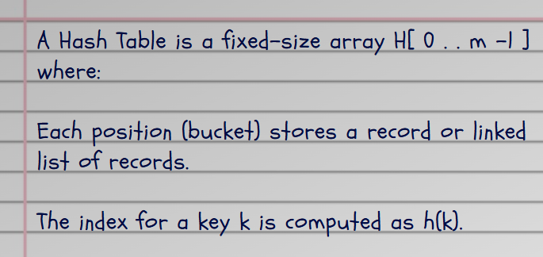
Hash Table

Slide 30
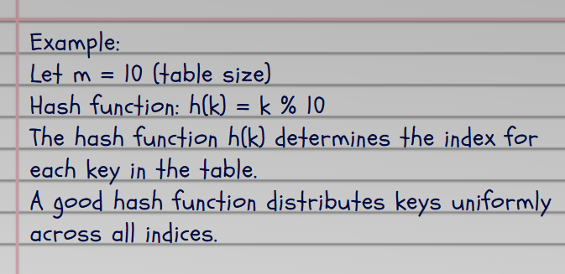
Hash Table

Slide 31
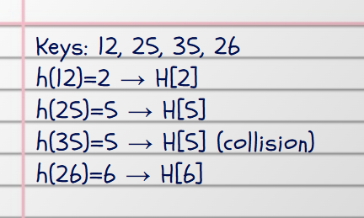
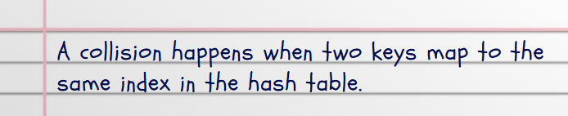
Hash Table

Slide 32
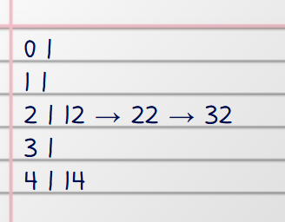
Collision Resolution Techniques
1. Separate Chaining (Closed Hashing)
Each index stores a linked list of all keys that map there.
If multiple keys go to the same index, we just chain them together in a linked list.
Slightly more memory (for pointers)

Slide 33
Collision Resolution Techniques
2. Open Addressing
Unlike separate chaining, all elements are stored directly in the hash table itself. If a collision happens, the algorithm finds another empty slot in the table — this is called probing.
No linked lists or extra pointers are used here.
Compute hash: index = h(key).
If table[index] is empty → insert key there.
If table[index] is full → use a probing method to find the next available slot.

Slide 34
Collision Resolution Techniques
Linear Probing
h(k,i)=(h(k)+i)%m
Start with i = 0 → check h(k).
If full, i = 1 → check h(k)+1.
Repeat until an empty slot is found.

Slide 35
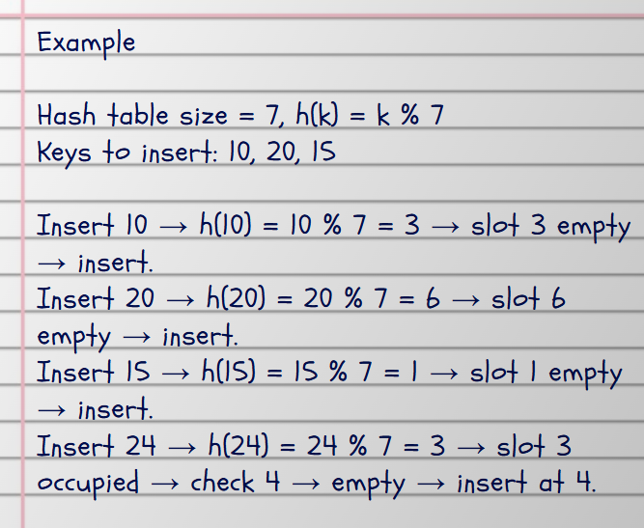
Linear Probing

Slide 36

Quadratic Probing
Instead of checking consecutive slots, jump quadratically: 1², 2², 3²…
Reduces clustering compared to linear probing.

Slide 37
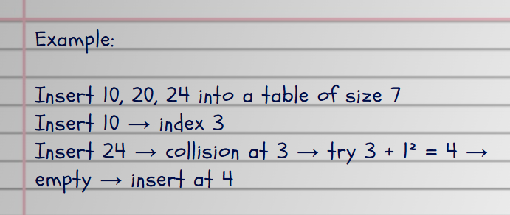
Quadratic Probing

Slide 38

Double Hashing
Use two hash functions: h1 for initial index, h2 for step size.
Reduces clustering even more than quadratic probing.

Slide 39
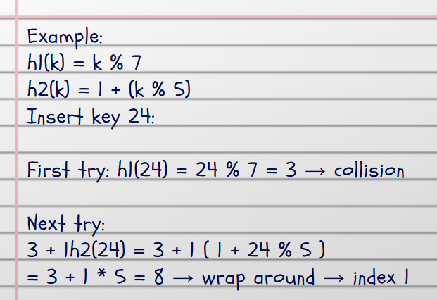
Double Hashing

Slide 40
Comparison of Collision Resolution Techniques
Method | Idea | Extra Space | Problem | Example/Use
Separate Chaining | Linked list at each index | Yes | Slower with long chains | Flexible memory use, good when memory is not tight
Linear Probing | Check next slot | No | Primary clustering | Simple, fast for low load
Quadratic Probing | Jump in squares | No | Secondary clustering | Medium load factor
Double Hashing | Use 2 hash functions | No | More complex to compute | Best performance, fewer collisions

